Slide 1
A Real Time Application to Identify Alcoholics from ECG Signals
Akarsh N Kolekar (1PI13EC009) Guide: Dr. b Niranjana Krupa
Apoorv Vatsal (1PI13EC017)
Rakshith Vishwanatha (1PI13EC075)

Slide 2
Objective
To develop a prototype to read ECG signals
Extract features from ECG signal to perform HRV analysis
Classify the person under test as an alcoholic or otherwise, in real time.

Slide 3
Need for Project
To address the disadvantages of breathalyzers:
Contamination of SiO2 sensor -- frequent recalibration
Breathalyzers medium for contagious diseases
Interfering components (like acetone) -- detected falsely
Meaningful readings got from breathalyzers only for few hours port drinking

Slide 4
Literature Survey
The paper “Effects of Alcohol on the Electrocardiogram” took electrocardiograms of 1,000 chronic alcoholic patients and analyzed them to find evidence that excessive consumption of alcohol may produce changes in the electrocardiogram.
In the “A Precise Drunk Driving Detection Using Weighted Kernel Based on Electrocardiogram” paper the authors collected ECGs from 50 volunteers. To identify characteristics of an alcoholic, features such as Pmax, Pd, means and variances of P, R, S waves and R-R intervals are extracted. The paper used SVM as a classifier and 10-fold cross validation.

Slide 5
Literature Survey
The “Circuit Design for Front-End Electrocardiograph”, “Techniques for accurate ECG signal processing”, “Electrocardiogram (ECG) circuit for use with oscilloscopes” and “ECG Circuits, Signal Sampling and Digitalization” detailed the circuit elements that would be required in order to amplify the differential signal, filter out the different kinds of noise present in it.
In “What are Extreme Learning Machines? Filling the Gap Between Frank Rosenblatt’s Dream and John von Neumann’s Puzzle”, the author describes the architecture of ELM and compares it with SVM and LS-SVM.

Slide 6
Physiological Effects of Alcohol
Explanation effects of alcohol on ECG/physiology
Kole diagram
Has to clearly show that just HRV gives all the different domains (time, freq, non-lin, ARX) of features

Slide 7
Methodology
Main verticals of the project:
Hardware Design
ECG signal acquisition
Software
Pre-processing
Feature Extraction
Classification
Raspberry Pi
Real-time, Portability

Slide 8
Methodology
Validate HRV as a method to detect effects of alcohol. Study of advantages and disadvantages of HRV analysis
Familiarization with the form and structure of the ECG signals, and understanding distortions (artefacts) that can occur in the signal.
Survey of available devices for measuring and recording ECG signals is done.
Preprocessing the signal to remove artefacts, and then time domain, frequency domain, and non-linear methods are used for feature extraction from the ECG signals.

Slide 9
Methodology (contd.)
Training of classifiers using extracted features
Extensive cross validation over several iterations in order to find weights and biases that give highest accuracy.
Interface sensor with Raspberry Pi and verify signal acquisition by storing sampled values in CSV file and plotting waveforms.
Implement feature extraction and classification codes on Raspberry Pi using Python.

Slide 10
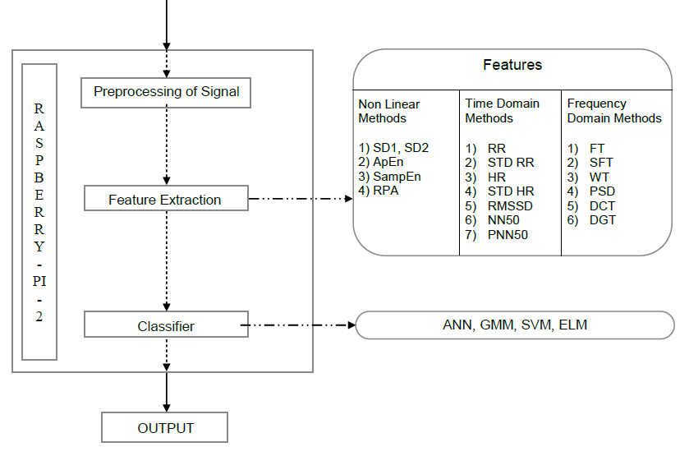
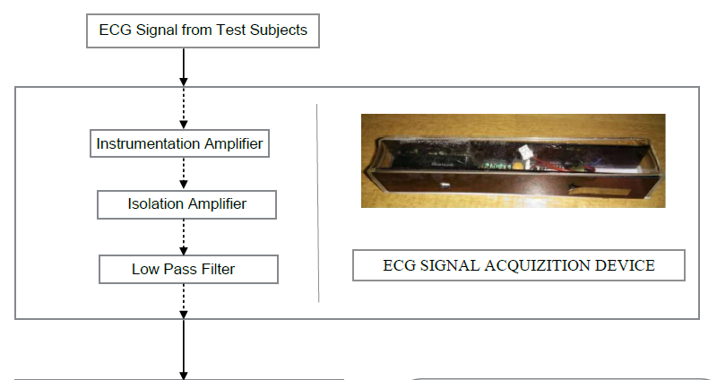
Overall Flow/Methodology
1) PSD
SVM , ELM

Slide 11
Hardware
Main sensor circuit consists of:
Instrumentation Amplifier
High Pass Filter
Low Pass Filter
Notch Filter
Several circuit designs were simulated on Multisim.
Designed filters depending on what frequencies needed to be filtered.
Started soldering components onto circuit boards.
Alternatively, started interfacing AD8232 based sensor with Raspberry Pi. Also used an ADC MPC3008 since R-Pi doesn’t have it inbuilt.
Captured ECG samples using setup and stored it as CSV file on R-Pi.

Slide 12
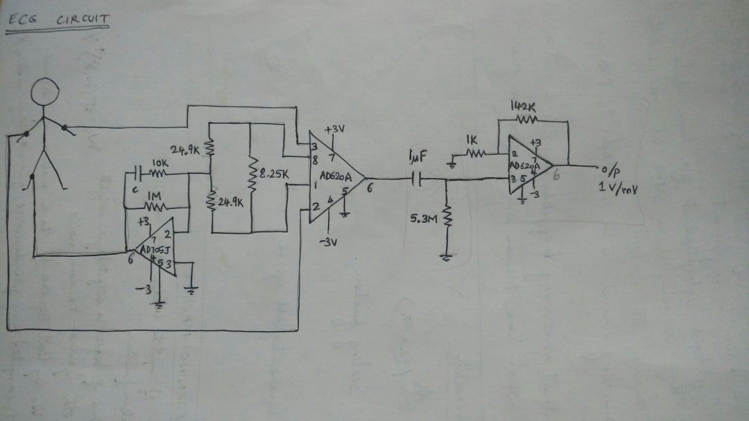
Circuit Design – 1

Slide 13
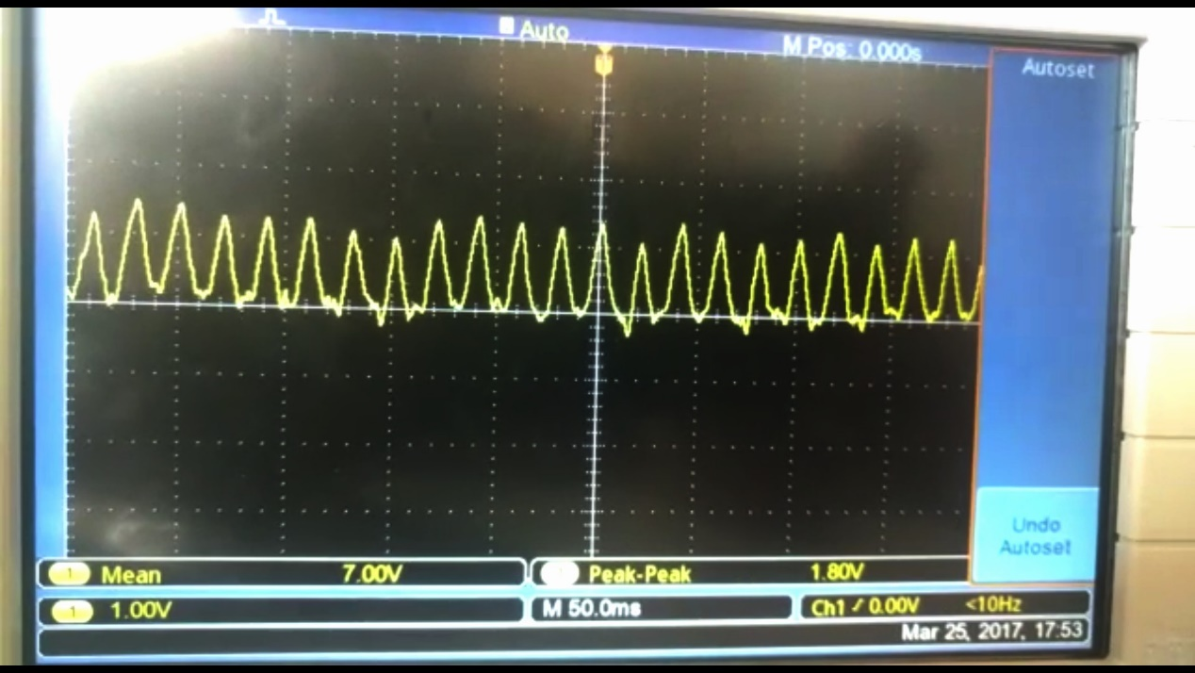
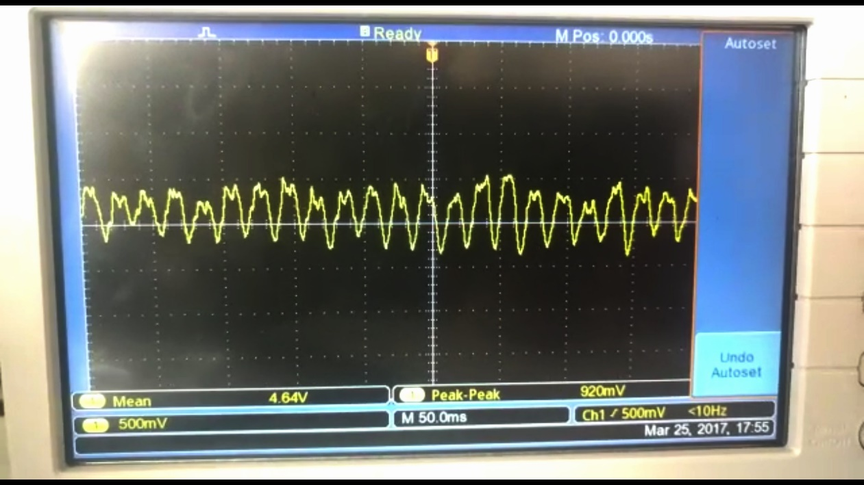
Need for Notch Filter

Slide 14
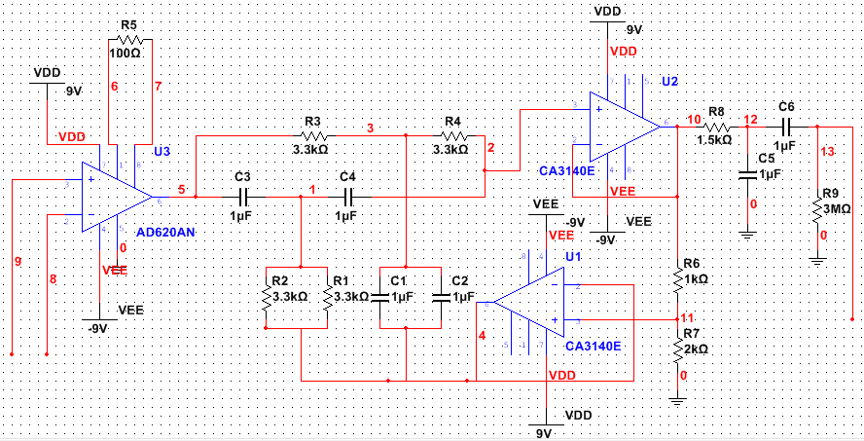
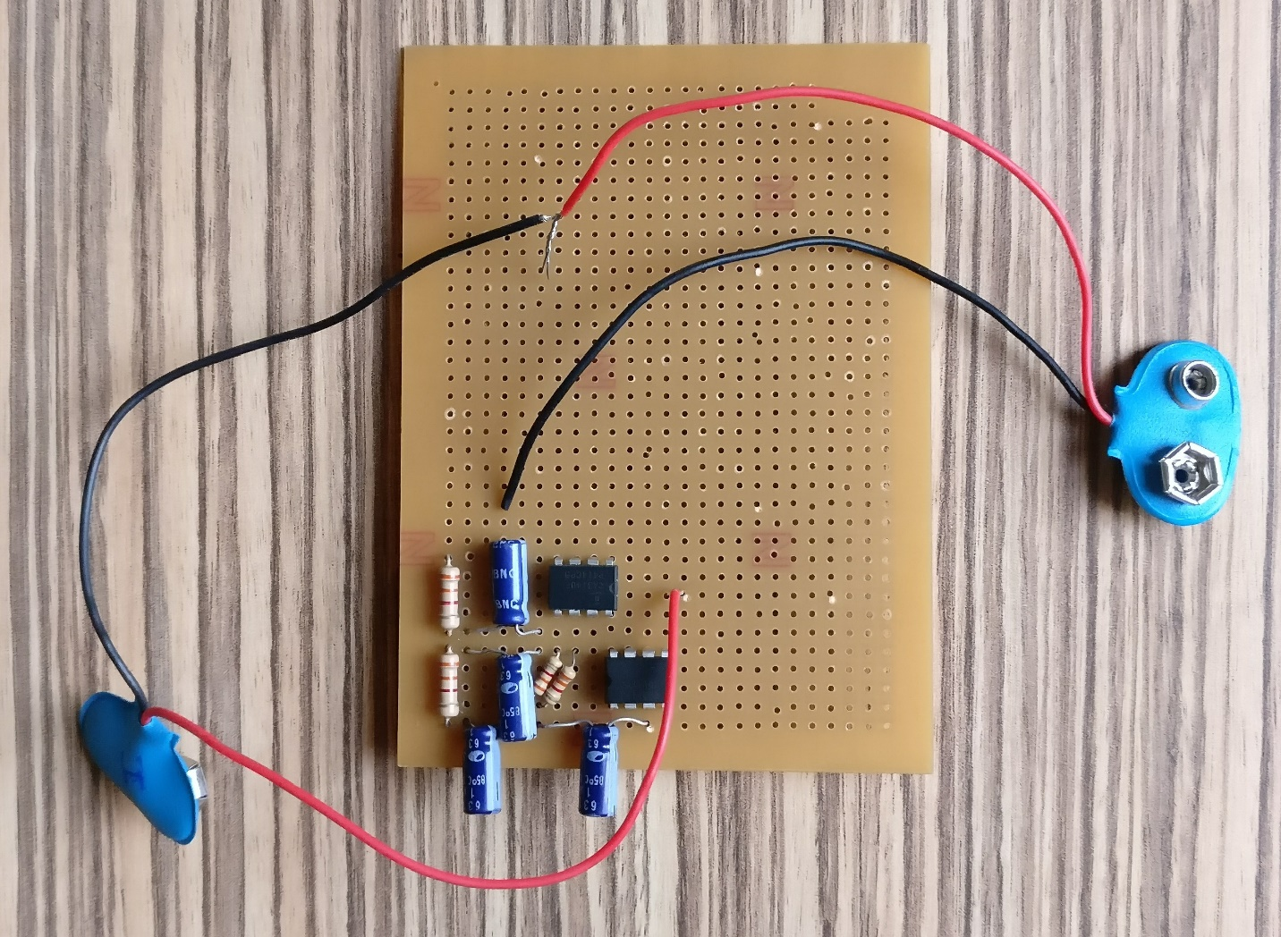
Circuit Design – 2

Slide 15
Software – Dataset Description
Dataset obtained from Autonomic lab, NIMHANS, Bengaluru.
Total number of ECG samples = 67 of just 2 classes
Number of Alcoholic subject samples = 38
Number of Non Alcoholic subject samples = 29
ECG data obtained from test subjects at sampling frequency of 1kHz.
Each sample at NIMHANS was recorded for a duration of 5 minutes, which gave a CSV file containing 300,000 values.

Slide 16
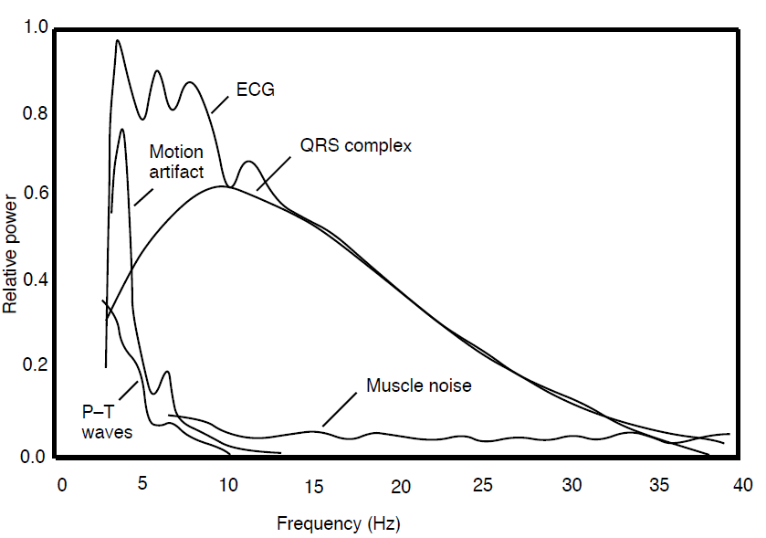
Software Pre-processing
ECG signal contains
Baseline wandering
Power-line interference
Motion artefacts
IIR HPF (f_cut = 5Hz - 7Hz, rp = 0.2, rs = 1) to
Remove baseline wandering
Suppress motion artefacts
Sufficient for only time domain and non-linear
Wavelet Transform
Remove baseline wandering
Remove (almost completely) all other artefacts
Satisfies requirement of clean signal for frequency domain

Slide 17
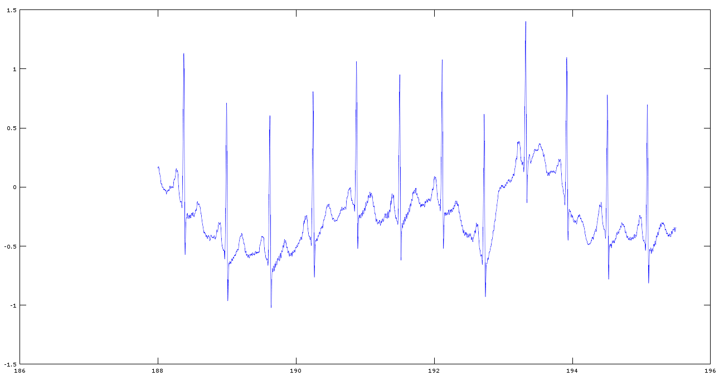
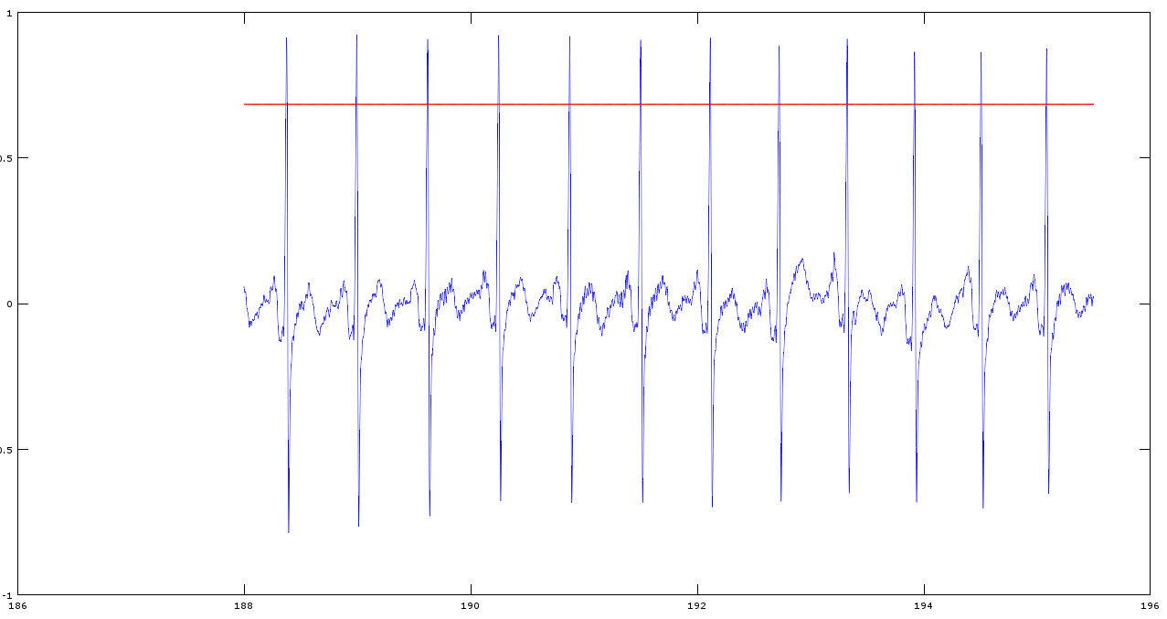
IIR Filtered Signal
Original Signal in Dataset
IIR Filtered Signal

Slide 18
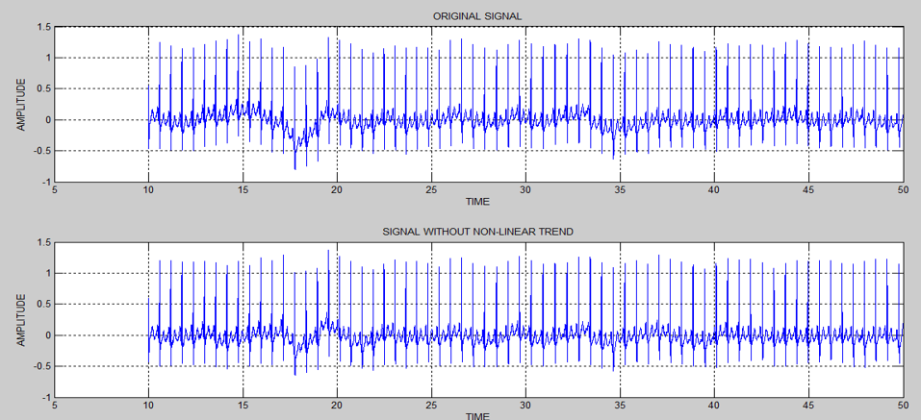
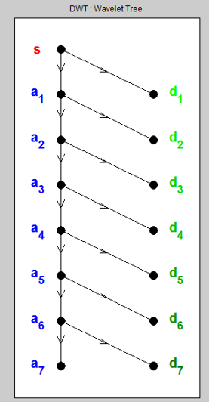
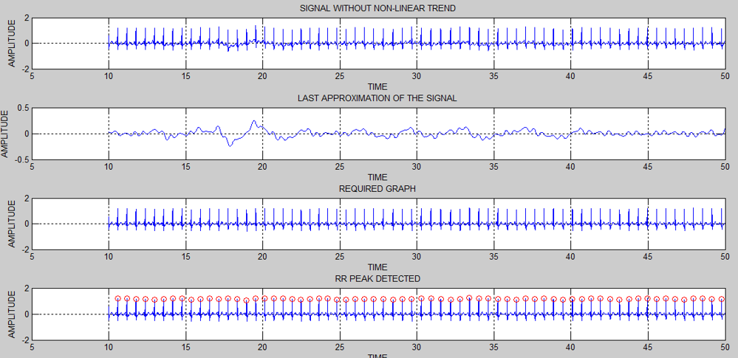
Wavelet Decomposed Signals

Slide 19
Software – Feature Extraction
Types:
Time Domain features
Depend on R-R peak intervals
Frequency Domain features
Depend on Power Spectral Density
Non Linear features
Depend on R-R peak intervals
ARX coefficients
Obtained coefficients of different orders

Slide 20
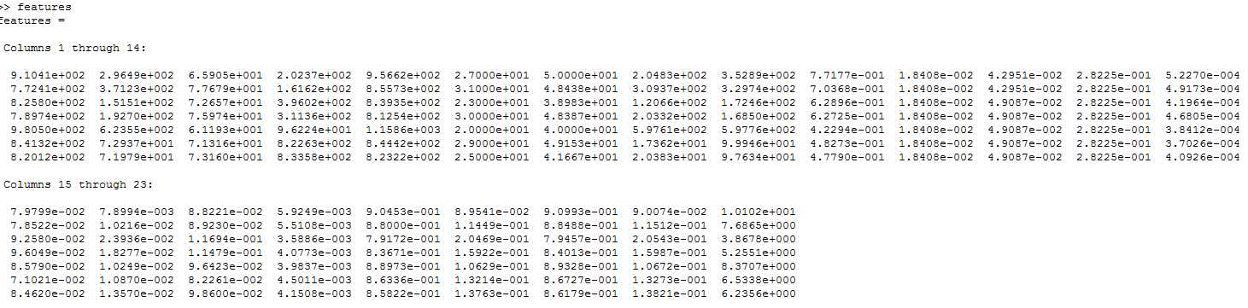
Feature Set for a Sample
[ rr_mean, rr_std, HR_mean, HR_std, rr_rms, rr_50, nrr_50, sd1, sd2, apen,
pk_freq_vlf, pk_freq_lf, pk_freq_hf, ab_pow_vlf, ab_pow_lf, ab_pow_hf, pw_ttl, rp_vlf, rp_lf, rp_hf, norm_lf, norm_hf, ratio, [ARX_coeffs] ]

Slide 21
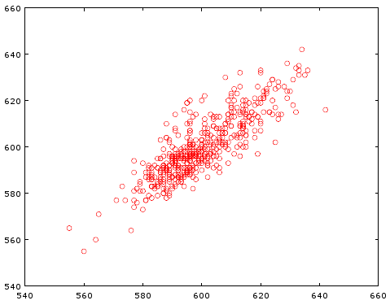
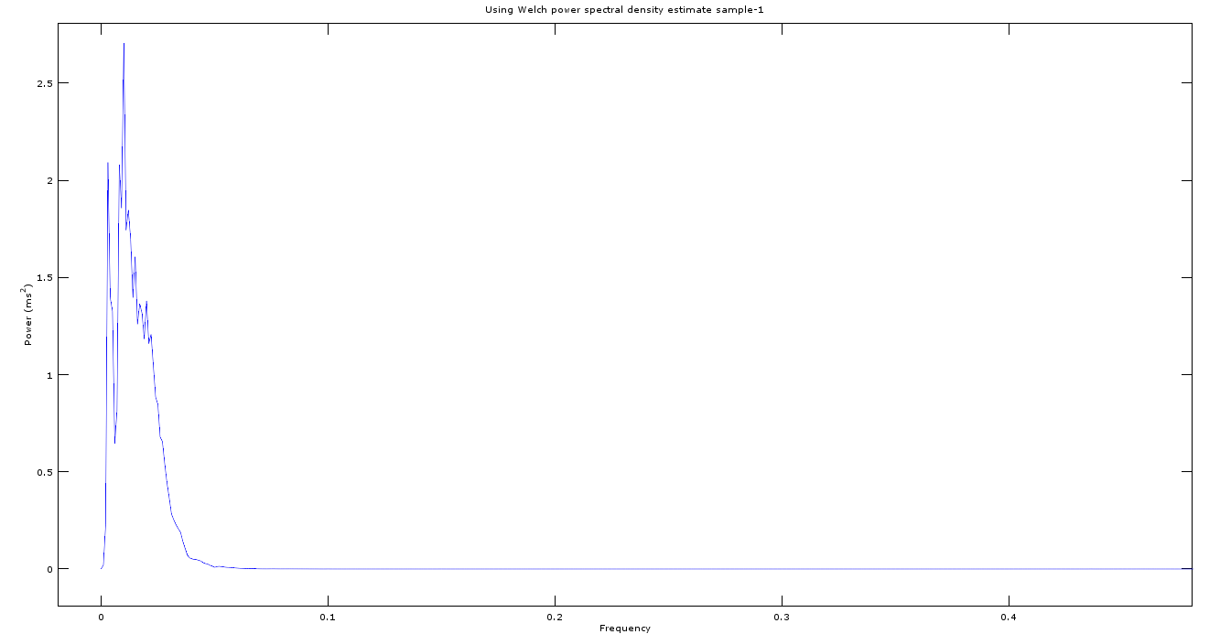
Visualisable Features
Poincare Plot – relates i-th RR interval with next RR interval
PSD of Wavelet Decomposed Signal

Slide 22
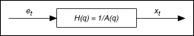
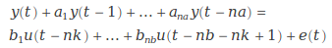
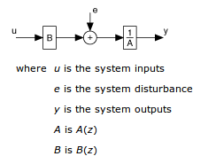
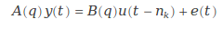
Feature Extraction – ARX
APOORV
AR Model Structure:
ARX Model Structure:

Slide 23
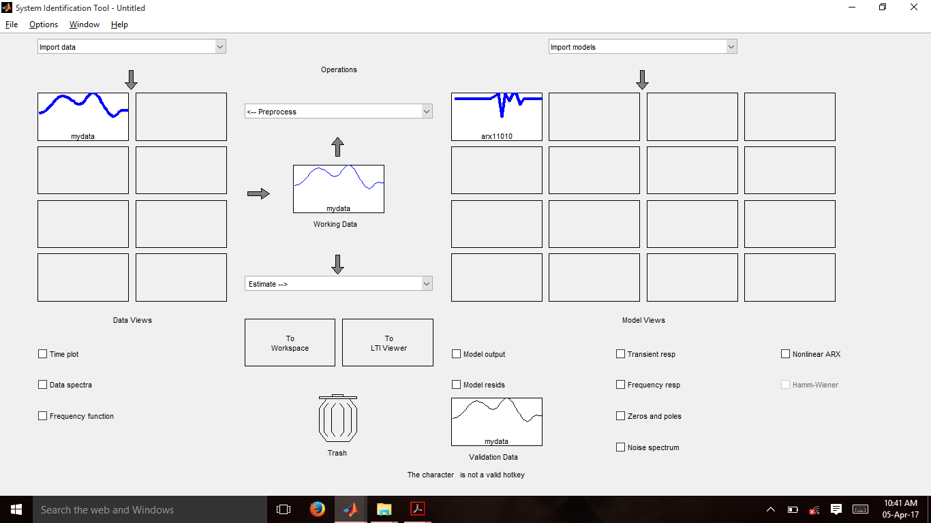
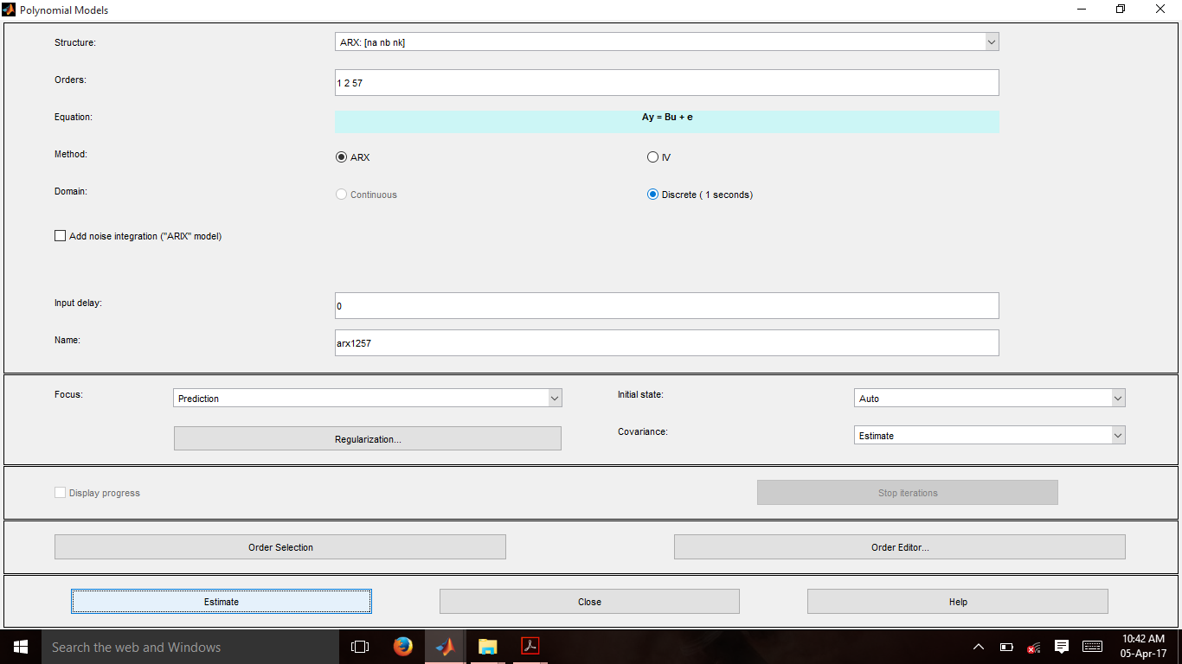
Feature Extraction – ARX
System Identification toolbox

Slide 24
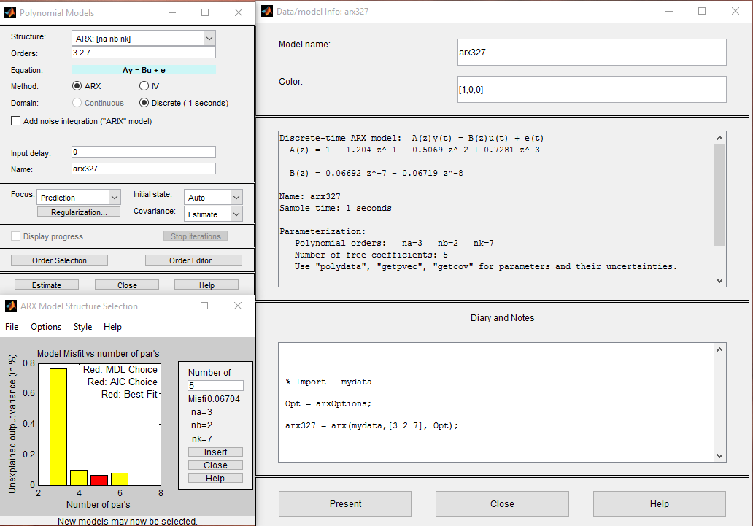
Feature Extraction – ARX

Slide 25
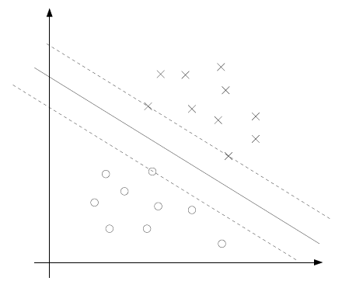
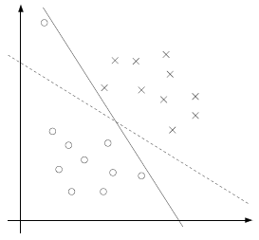
Classifiers – SVM
Decision boundary/primary hyperplane idea to separate
different classes of data
Maximize the margin between the supporting hyperplanes
Need to solving the Lagrangian Dual to obtain the weights for the primary hyperplane
Simplified SMO algorithm used to solve Lagrangian Dual
Initialization of alpha and b not optimal
Accommodation of outliers if no regularization – choice of regularization parameter ‘C’

Slide 26
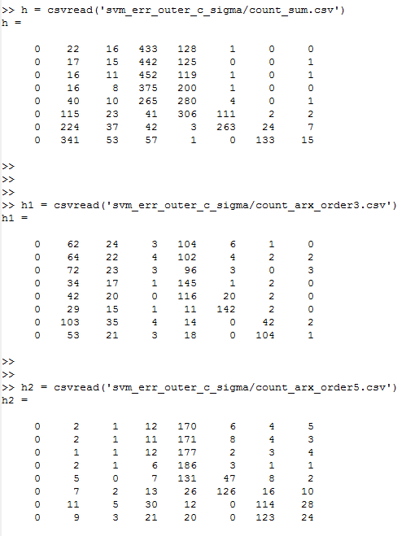
Classifiers – SVM
Gaussian Kernel used to take samples to a new dimension for easier separation -- choice of sigma
The system was re-trained 400 times. In each loop, dataset was split randomly for classification and validation using crossvalind().
Now, for each set of randomly set classification and validation groups, all pairs of C and sigma were looped through to see which C and sigma resulted in highest accuracy.
Similarly, a loop was run 200 times to find optimal C and sigma when order 3 and order 5 ARX features were included

Slide 27
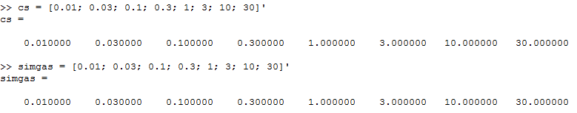
Classifiers – SVM
C and sigma values:
No ARX: C = 0.1, sigma = 0.3 [ 80% ]
ARX order 3: C = 0.3, sigma = 1 [ 82% ]
ARX order 5: C = 0.3, sigma = 1 [ 86% ]
ARX order 5 gave better accuracy due to better concentration
To test how many TP and TF were occurring (for ARX order 5), confusion matrix was calculated after setting the C and sigma as given above:
Sensitivity was found to be = 89%
Specificity was found to be = 82%
25 | 3
5 | 23

Slide 28
Classifiers – ELM
Feed forward neural network
Single Hidden Layer
Random assignment of Input Weights
Fixed Network Architecture
Number of Hidden Layer Neurons fixed before training
Known for high speed of training
Also known to produce good generalisation for low number of training data

Slide 29
ELM (cont.)
Leave-one-out validation and K-fold cross validation(k=7)
balanced dataset of 28 alcoholic samples and 28 non-alcoholic samples (total of 56 samples).
Sigma value was varied, and the number of hidden layer neurons was varied for each sigma, and a plot of accuracy vs. number of hidden neurons was plotted.
Each training-testing iteration was done 20 times to obtain the weights and biases for which maximum accuracy was obtained.
These weights and biases were saved onto a CSV file which would then be imported into the Python classifier code, which would run on the Raspberry Pi.

Slide 30
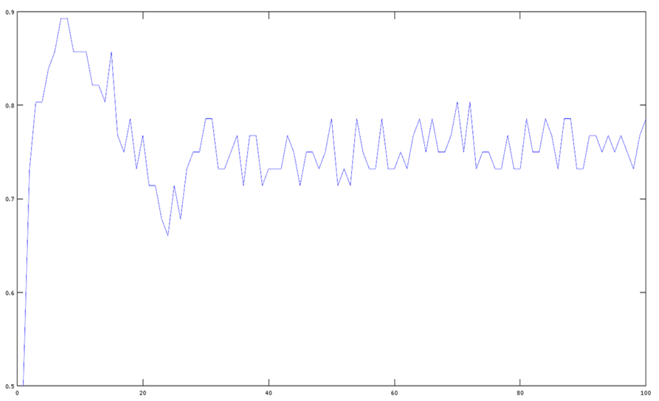
ELM (cont.)
Accuracy
Number of Hidden Neurons

Slide 31
ELM (cont.)
Leave-one-out validation (with ARX order 5)
Accuracy for Leave-one-out validation = 92.86%
Sigma = 2
Number of Hidden Neurons = 6
7-fold cross-validation (without ARX coefficients)
Accuracy for 7-fold cross validation = 89.29%
Sigma = 1.4
Number of Hidden Neurons = 6

Slide 32
ELM (cont.)
7-fold cross-validation (without ARX order 3)
Accuracy for 7-fold cross validation = 92.86%
Sigma = 2
Number of Hidden Neurons = 7
7-fold cross-validation (with ARX order 5)
Accuracy for 7-fold cross validation = 94.64%
Sigma = 1.8
Number of Hidden Neurons = 15

Slide 33
ELM (cont.)
Confusion matrix (without ARX) was calculated as follows:
Sensitivity was found to be = 92.86%
Specificity was found to be = 85.71%
26 | 2
4 | 24

Slide 34
Classifiers – McELM
For ELM, to find number of hidden layer neurons which gives best accuracy without over-fitting, the number of neurons was varied between a certain range.
McELM provides an intelligent way of choosing and adding neurons based on some criteria during the training phase, instead of using the brute force method to obtain an optimal solution.
We have gone through the algorithm and this is part of future work.

Slide 35
SVM vs ELM
K-fold Cross validation:
Without ARX:
80% vs 89%
With ARX order 5:
86% vs 94%
Confusion Matrix:
vs
25 | 3
5 | 23
26 | 2
4 | 24

Slide 36
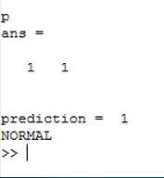
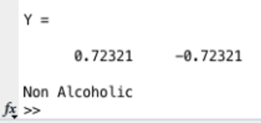
MATLAB Classification – Nearly Real Time
SVM’s Prediction
ELM’s Prediction

Slide 37
Raspberry Pi - Python Implementation
Interfacing of sensor to R-Pi via ADC
1kHz sampling of signal implemented with timer() class to match training dataset
Code to obtain and save sampled values from sensor was written in Python.
Feature extraction codes except for the frequency domain features have been implemented in Python.
ELM and SVM Classifiers have been implemented in Python.

Slide 38
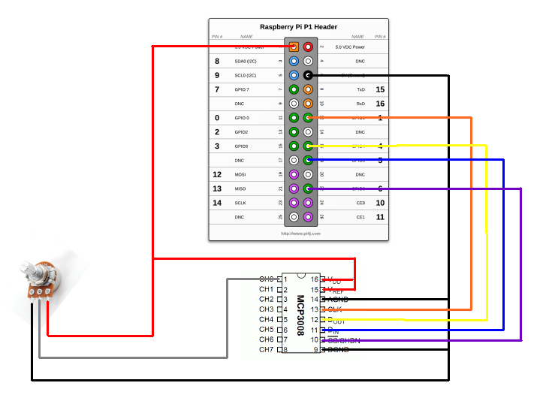
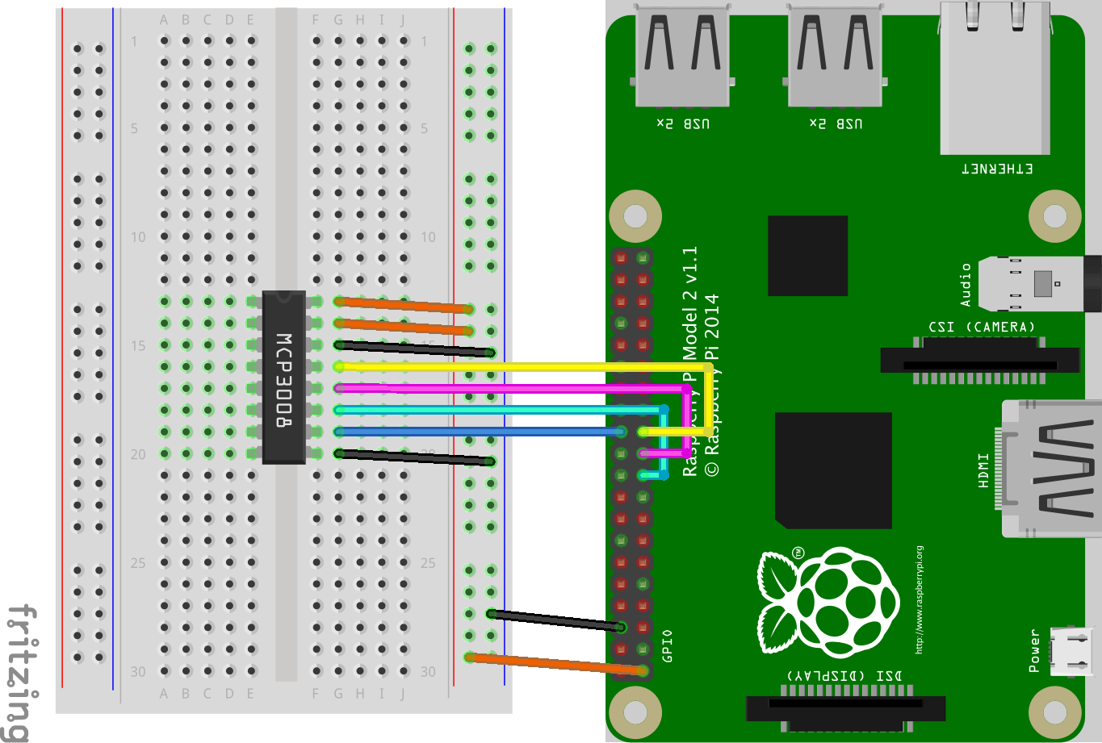
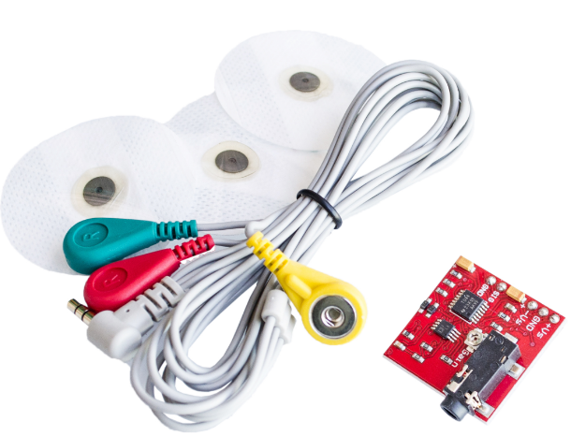
Analog Sensor Interface to R-Pi

Slide 39
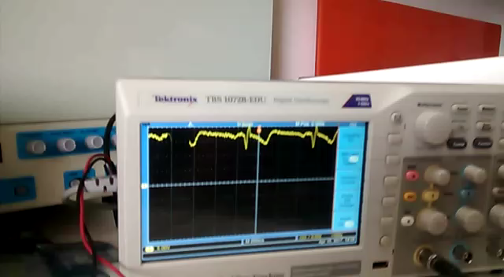
ECG Signal Capture

Slide 40
Wrap Up Before External Review
RAKSHITH
Optimize features required using combnk() and compare SVM and ELM
Attempt full SMO algorithm to improve SVM accuracy
Complete the Report
APOORV
Integrate hardware and python code on the Raspberry Pi to make a complete system
Complete Report
AKARSH
Optimize features required using combnk() and compare SVM and ELM
Complete the Report

Slide 41
Summary and Future Work
Summary:
Classifiers can be applied to features extracted via HRV analysis
ELM classifier has a better accuracy than SVM
ARX features improve the accuracy of both ELM and SVM
Future Work:
Test the system on an alcoholic test subject
Implement Non-Linear ARX features to see if further improvements can be made on the accuracy of the system
McELM?
Multiclass classifier to detect different levels of alcoholic consumption

Slide 42
References
G.-B. Huang, “What are Extreme Learning Machines? Filling the Gap between Frank Rosenblatt's Dream and John von Neumann's Puzzle,” Cognitive Computation, vol. 7, pp. 263-278, 2015.
Andrew Ng, “Support Vector Machines”, 2011. [Online] Available: http://cs229.stanford.edu/notes/cs229-notes3.pdf Accessed: 10-Feb-2016
Andrew Ng, “The Simplified SMO Algorithm”, 2012. [Online] Available: http://cs229.stanford.edu/materials/smo.pdf Accessed: 10-Feb-2016
Branislav Vuksanovic & Mustafa Alhamdi, “AR-based Method for ECG Classification and Patient Recognition,” International Journal of Biometrics and Bioinformatics (IJBB), vol. 7 ,Issue 2, 2013
Dingfei Ge, “Cardiac arrhythmia classification using autoregressive modelling”. [Online] Available: http://biomedical-engineering-online.biomedcentral.com/articles/10.1186/1475-925X-1-5

Slide 43
References
Pico Technoology, “Electrocardiogram (ECG) circuit for use with oscilloscopes”. [Online] Available: https://www.picotech.com/library/application-note/electrocardiogram-ecg-circuit-for-use-with-oscilloscopes
Lv Jinhua and Xu Yanyi, “Circuit Design for Front-End Electrocardiograph”, International Journal of Multimedia and Ubiquitous Engineering Vol.11, No.5 (2016), pp.345-354
Ajay Bharadwaj and Umanath Kamath, Cypress Semiconductor Corp., “Techniques for accurate ECG signal processing” [Online] Available: http://www.eetimes.com/document.asp?doc_id=1278571
NTHU, “ECG Circuits, Signal Sampling and Digitalization” [Online] Available: https://www.google.co.in/url?sa=t&rct=j&q=&esrc=s&source=web&cd=1&cad=rja&uact=8&ved=0ahUKEwins5jwg43TAhWCq48KHcxPAysQFgggMAA&url=http%3A%2F%2Flms.nthu.edu.tw%2Fsys%2Fread_attach.php%3Fid%3D692351&usg=AFQjCNFJqOwwhxZZG0FP1yQNMuNpHBV73Q&sig2=e_-aLgXrLbFMIB-XhTd2Kg

Slide 44
References
L. Ljung,“System identification toolbox,” The Matlab user’s guide, 2012. [Online] Available: http://radio.feld.cvut.cz/matlab/pdf_doc/ident/ident.pdf
Hong He, Xiaowen Yan and Wei Wei, “Meridian ECG Information Transmission System Modeling Using NARX Neural Network” ,IEEE/ACIS 15th International Conference on Computer and Information Science (ICIS), 2016. [Online] Available:http://ieeexplore.ieee.org/document/7550775/
R. Savitha, S. Suresh, H.J. Kim, “A Meta-Cognitive Learning Algorithm for an Extreme Learning Machine Classifier” Cognitive Computation, vol. 6, pp. 253-263, 2014.

Slide 45
Changes – delete after done
Problem statement
Physiological effects with the literature survey
Methodology as a table on contents
Clear screenshots
Summary and future work
Elm better
Arx improves
Test on alcoholic samples
Nlarx
Mcelm
multiclass

